Slide 1
COVID-19 Through the Lens of Data: Unveiling Patterns and Insights
BY: Madelin Paredes, Kiryl Hnidash, Kevin Rivera, Laavanya Kumaar, & Maria Madalina Stefanescu

Slide 2
Project Goals
📊 Analyze the Impact of Covid-19
📉 Visualize Key Trends
🧠 Highlight Mental Health Effects
📢 Raise Awareness
📈 Provide Evidence-Based Insights

Slide 3


Why This Matters
The COVID-19 pandemic reshaped the world, leaving a lasting impact on public health, mental well-being, and mortality rates. This project explores key data insights, analyzing death rates across the U.S. and other countries, the impact of the Covid vaccinations, the role of comorbidities in fatal outcomes, and the pandemic’s effect on mental health. By visualizing these trends, we aim to highlight the broader implications of COVID-19, using data to tell the story of its widespread consequences. Through this analysis, we seek to provide a clearer understanding of how the pandemic affected individuals and healthcare systems worldwide.

Slide 4
The Power of
Inquiry
We’ve proposed questions about the data we’ve analyzed collectively in order to give us a better understanding of the impact of COVID-19.
Each question will be supported by visualizations of our findings.

Slide 5
The questions we aimed to answer with our work and visualization
What we tried to achieve
Provide a clear, data-driven overview of COVID-19 case trends.
Identify the most affected regions and highlight key milestones.
Show how case trajectories differed across locations.
How did COVID-19 cases evolve over time globally and in the U.S.?
Which countries and states had the highest case counts?
Were there significant trends or turning points in the pandemic’s progression?
Kiryl, 1

Slide 6
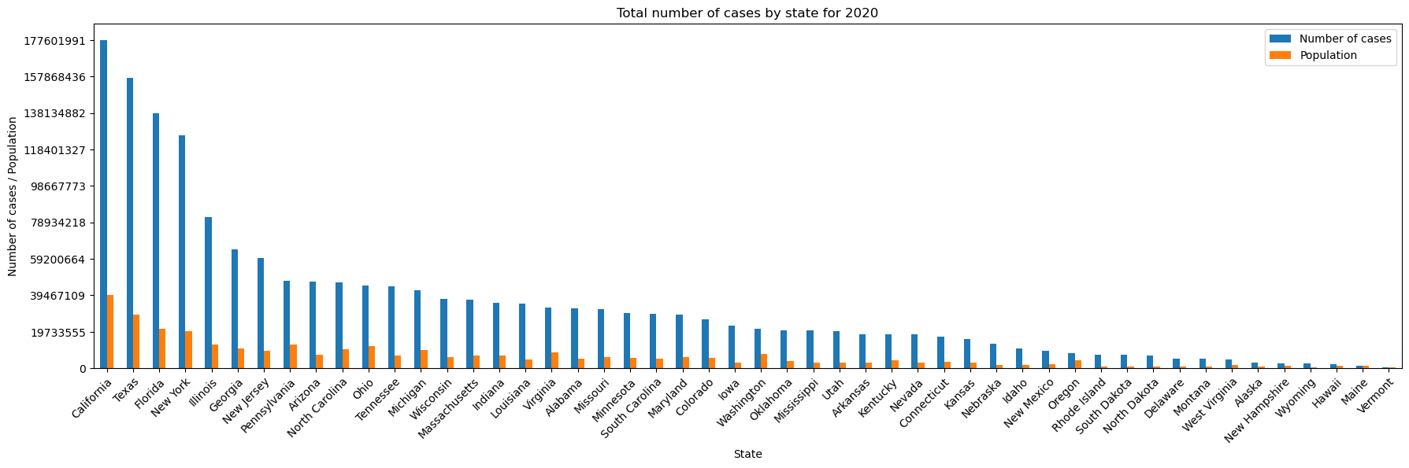
Total COVID-19 Cases by state in 2020
This bar chart shows the total number of COVID-19 cases across U.S. states in 2020. California, Texas, Florida, and New York had the highest case counts, significantly surpassing other states. The distribution highlights major differences in case numbers between the most and least affected states.
Kiryl, 2

Slide 7
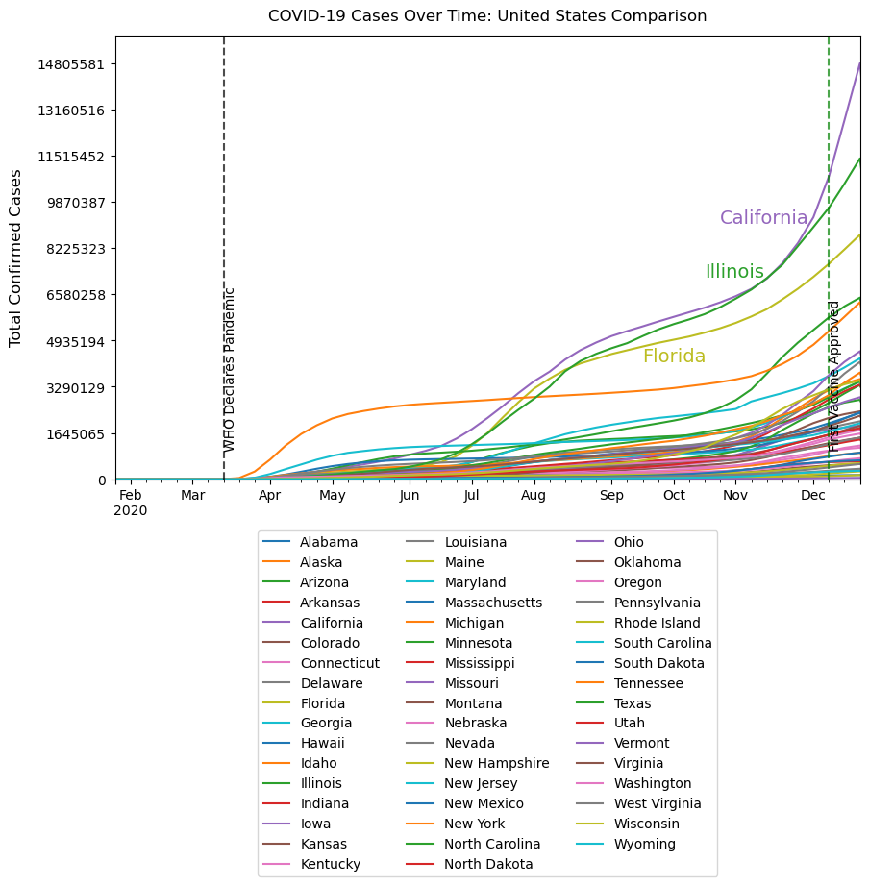
COVID-19 Case Trends Across U.S. States
This line graph tracks the progression of COVID-19 cases across all U.S. states. Major surges occurred after the WHO declared a pandemic in March, followed by additional waves later in the year. The data shows variations in how different states experienced and managed the outbreak.
Kiryl, 3

Slide 8
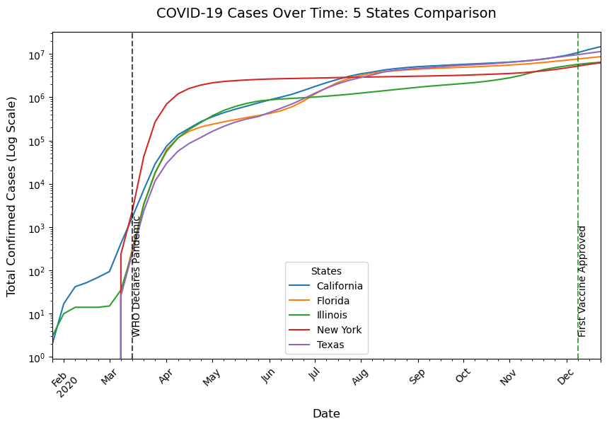
COVID-19 Cases over time: 5 states comparison
This graph focuses on the five states with the highest case counts—California, Texas, Florida, New York, and Illinois. It highlights the distinct trajectories of these states, showing rapid early spikes and steady increases over time.
Kiryl, 4

Slide 9
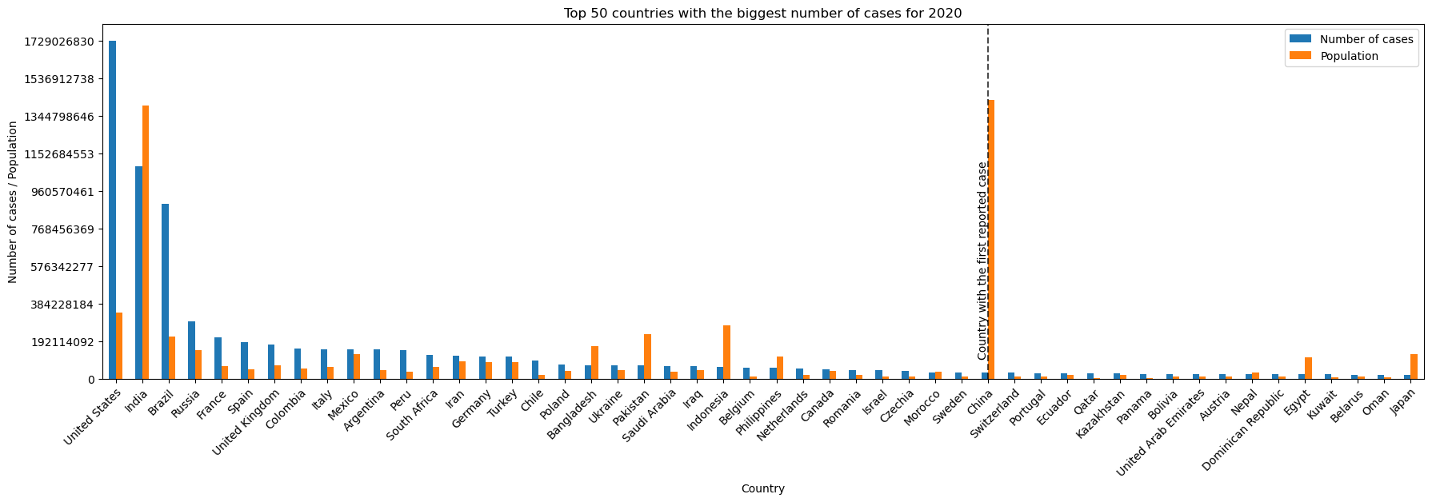
Top 50 countries with the biggest number of cases for 2020
COVID-19 cases surged globally in 2020. The U.S. recorded the highest total cases (1.7B+), followed by India, Brazil, Russia, and France. Notably, China, the first country to report COVID-19, is not among the top-ranked countries in total cases.
Kiryl, 5

Slide 10
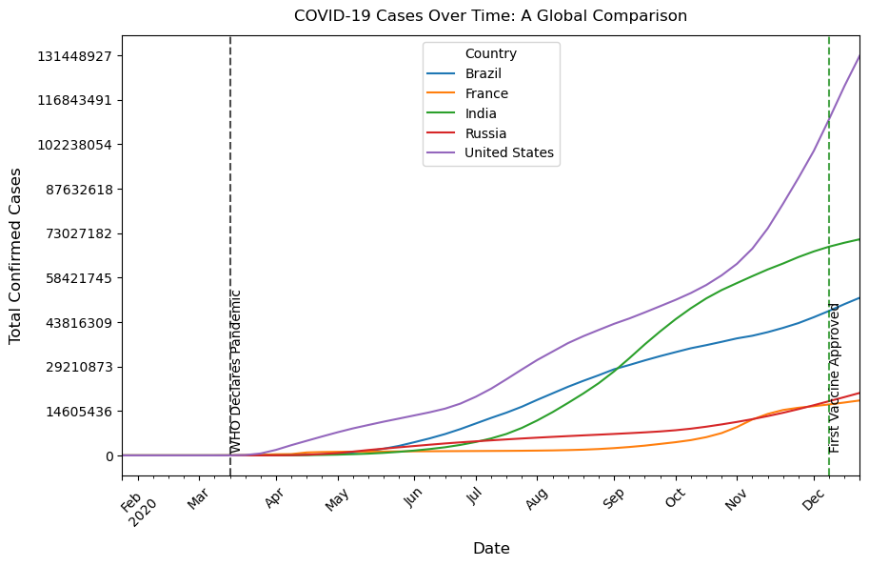
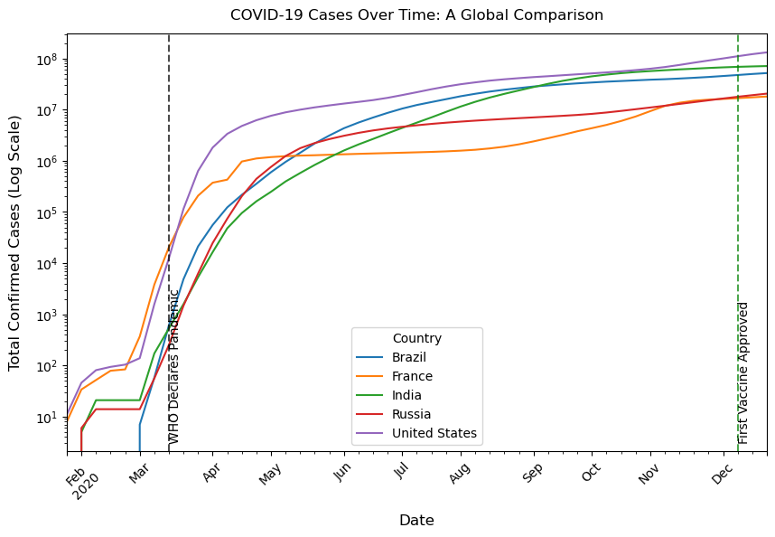
COVID-19 Cases over time: A global comparison
These graphs compare COVID-19 case growth worldwide. The left graph presents the raw number of cases, while the right graph uses a logarithmic scale to highlight exponential growth. Cases surged globally after the WHO declared a pandemic in March 2020, with rapid increases continuing through the year. India saw rapid growth mid-year, becoming the second most affected country. Notably, China, the first country to report COVID-19, is not among the top-ranked countries in total cases.
Kiryl, 6

Slide 11
Are there any trends?
Key observations
What we did with the data
Type of data used
Cases surged globally after the WHO declared a pandemic in March 2020.
The U.S. consistently had the highest total cases, with India experiencing rapid mid-year growth.
Multiple waves were observed, with a major spike toward the year-end.
Outliers: China, despite reporting the first case, had relatively lower total cases compared to other major countries. In the U.S., states like California and Texas had significantly higher case counts than others.
The U.S., India, and Brazil led in total cases.
California, Texas, Florida, and New York were the hardest-hit U.S. states.
China, despite reporting the first case, did not rank among the highest in total cases.
• Focused on the first wave and the growth rate of cases, limiting the analysis to the year 2020.
• Performed standard preprocessing:
1. Handled missing values (NAs).
2. Removed unnecessary columns.
3. Converted date columns to datetime format.
4. Merged data frames.
• Selected the top 50 countries with the highest total cases in 2020 for the global dataset to ensure a more focused analysis.
COVID-19 Data (John Hopkins University) Source: Key metrics: Daily confirmed cases by country and region.
World Population Data Source: Key metrics: Population estimates for countries worldwide; used to compare COVID-19 cases relative to population size.
U.S. Population by state data source: Key metrics: Population figures for individual U.S. states; used to normalize COVID-19 cases for state-level analysis.
Kiryl, 7

Slide 12
Conclusion
The data highlights the rapid global spread of COVID-19 in 2020, with major surges after the pandemic declaration in March. The U.S. recorded the highest cases, followed by India, Brazil, Russia, and France.
In the U.S., California, Texas, Florida, and New York were most affected. India’s mid-year surge made it the second hardest-hit country, while China did not rank among the highest.
With vaccines approved in December, their impact was not yet reflected. These trends underscore regional differences in the pandemic’s trajectory and response.
Kiryl, 8

Slide 13

Vaccinations
Which countries have the highest covid death rates?
How did global vaccination help reduce covid death?

Slide 14
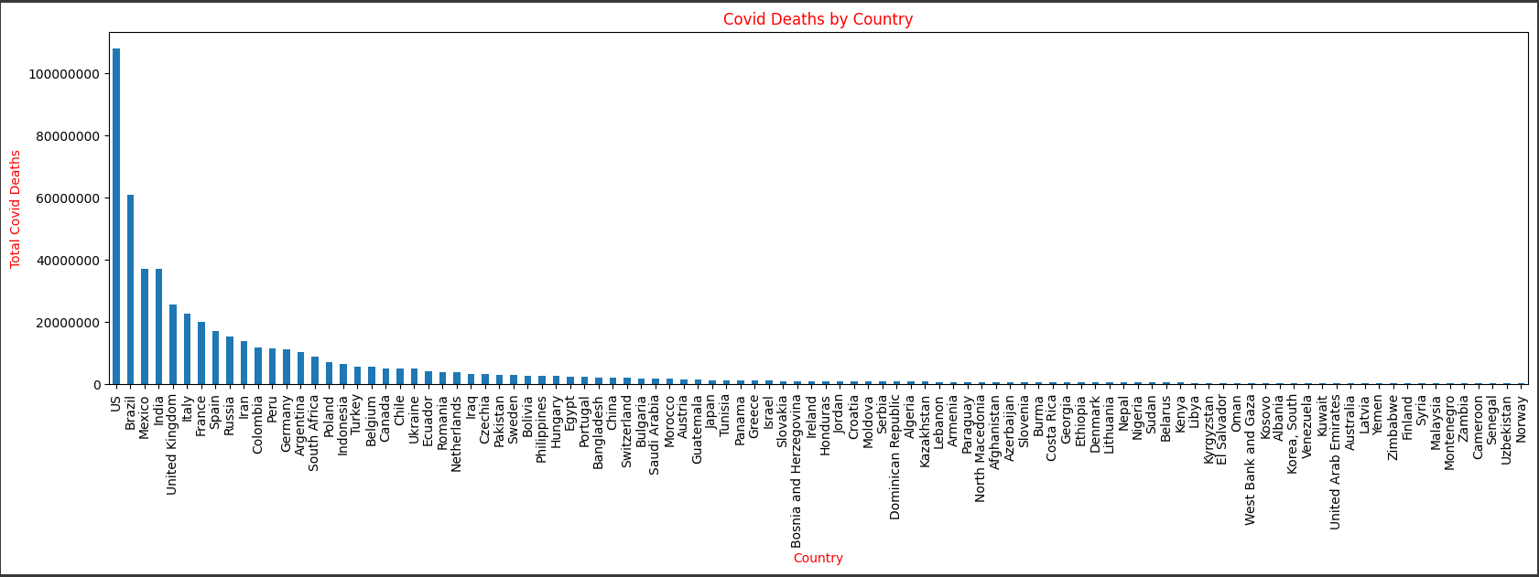
Total Covid deaths by Country
Research has shown that these figures are an underestimate of the total pandemic death toll. This is because of limited testing, poorly functioning death registries, challenges in determining the cause of death, and disruptions during the pandemic. In addition to the reported deaths, excess mortality is also included in the statistics to account for unreported deaths by covid. Excess mortality is a statistical term that refers to the additional number of deaths, from all causes, during a crisis, above the level we expect to see in “normal” conditions.
Laavanya

Slide 15
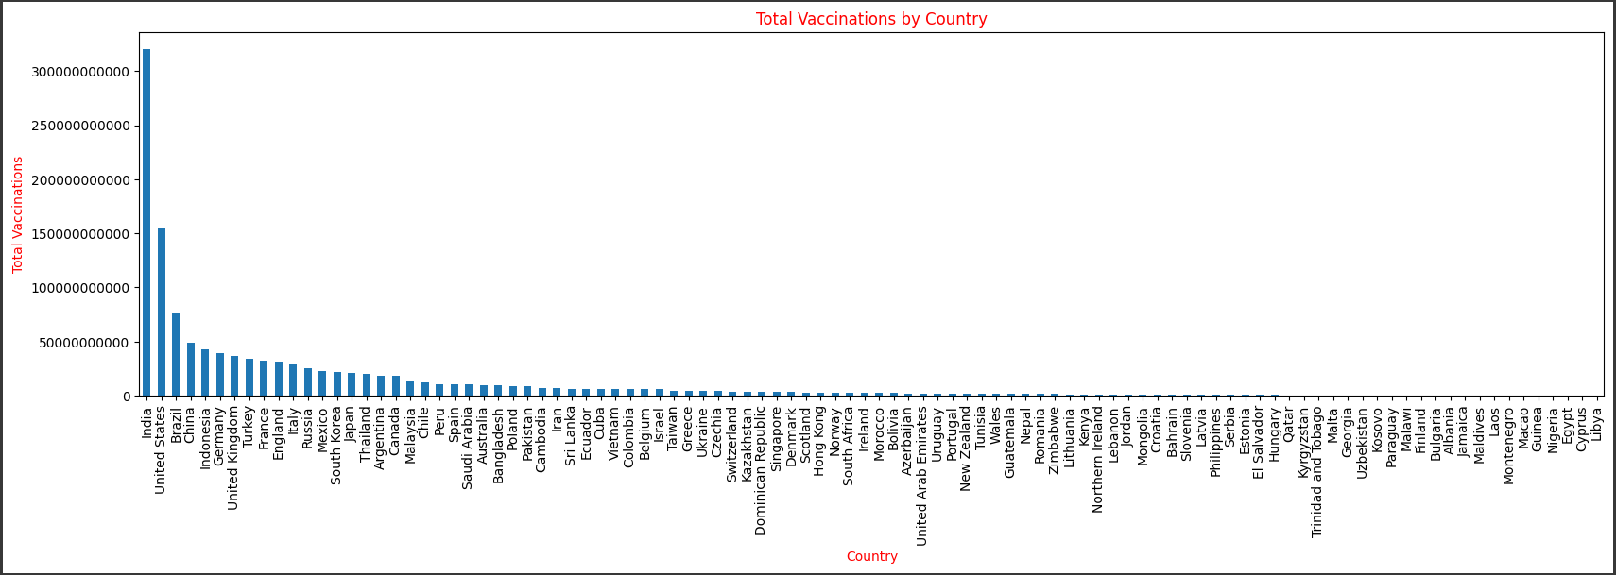
Vaccinations by Country
The vaccinations were first introduced in December 2020, the original COVID mRNA vaccines from both Pfizer and Moderna protected against the original SARS-CoV-2 virus. They have been replaced three times since then with shots targeting different iterations of the Omicron strain. As of April 13, 2024, 70.6 percent of people globally had received at least one dose of a COVID-19 vaccine. In low-income countries (LMICs), however, only 32.7 percent of people had received one dose. Approximately 5.18 billion people have completed the initial COVID-19 vaccination protocol.
Laavanya

Slide 16
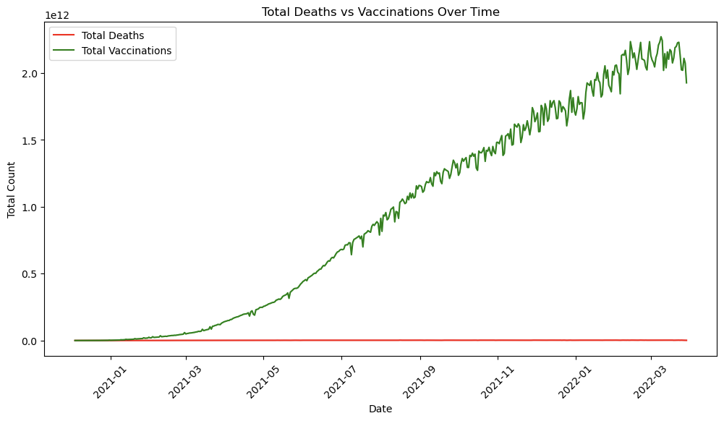
"Did the vaccine actually help prevent deaths?”
Visualizations:
Total Deaths vs Total Vaccinations: This plot shows the number of deaths and vaccinations over time.
Madda
Notes:
Madalina Maria S.

Slide 17
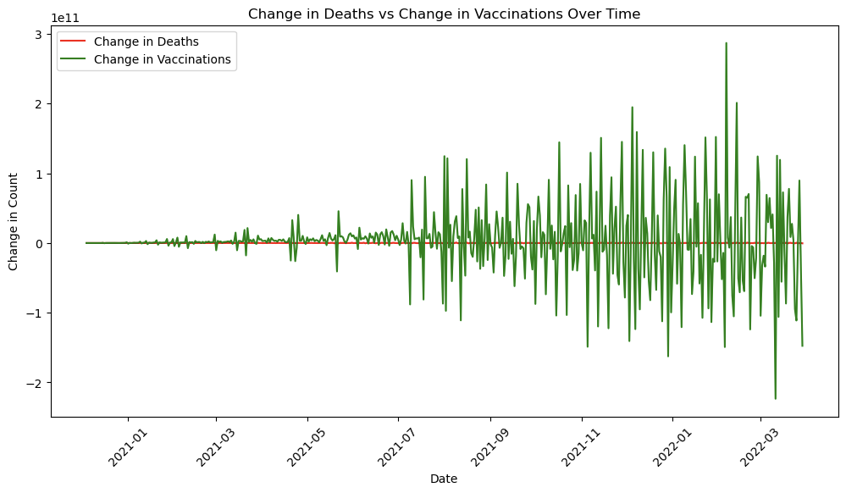
Change in Deaths vs Change in Vaccinations: This plot shows how the daily changes in both metrics correlate.
Findings: The mortality rate decreased significantly after the large-scale vaccination efforts began. A clear correlation between the increase in vaccinations and a decrease in deaths is observable.
Mada
Notes:
Madalina Maria S.

Slide 18
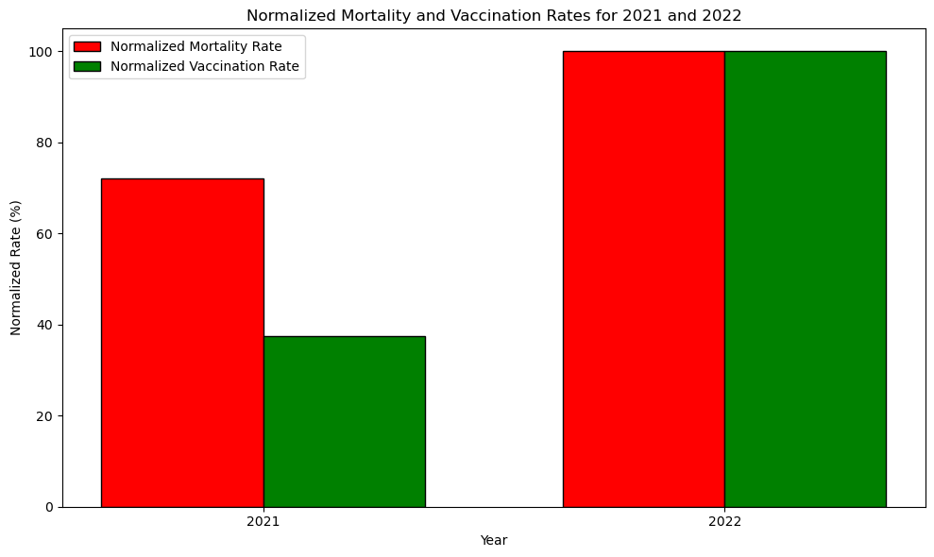
Mada
Notes:
Madalina M.

Slide 19
1. Data Understanding
The data contains:
Date: The date of vaccination and death count.
Total Vaccinations: The cumulative number of vaccinations administered on that date.
Total Deaths: The cumulative number of deaths up to that date.
Mortality Rate: The ratio of deaths to total population or some other metric (likely related to total cases or population).
Vaccination Change: The difference in the number of vaccinations between consecutive days.
Death Change: The difference in deaths between consecutive days.
From this, we can make observations about the overall trend of deaths and vaccinations over time.
2. Key Metrics
To answer the question about the impact of the vaccine on preventing deaths, we'll focus on the following metrics:
Mortality Rate: This will help us track if the death rate declines as vaccination rates increase.
Total Vaccinations: As the vaccine rollout progresses, if deaths decrease while vaccinations increase, this could suggest that the vaccine helped prevent deaths.
Death Change: This shows whe
Mada
Notes:
Madalina M.

Slide 20
3. Looking at the Trends
a. Vaccination Rate vs Death Rate
The total vaccinations increase over time, particularly starting around December 2020 and accelerating in 2021.
The total deaths initially might show an increase, but as vaccinations ramp up, we expect to see a slowdown in the growth of deaths or a decrease in mortality rates if vaccines are having an impact.
To better assess whether the vaccine prevented deaths:
Compare mortality rate trends over time with vaccination trends. If mortality rates decrease as the vaccination numbers rise, it suggests a possible positive effect of vaccination on preventing deaths.
b. Change in Mortality and Vaccination Rates
You can also look at the mortality rate compared to the vaccination change. There are sharp declines in the death rate after significant increases in the vaccination rate, it supports the idea that vaccines helped reduce deaths.
4. Key Observations
Looking at some specific data points:
From Dec 2020 to early 2021: As vaccinations start, the death change appears to rise steadily, but the rate of increase in deaths might slow down as vaccination numbers increase.
From 2021 onwards: The increase in vaccinations accelerates, and by late 2021 and into 2022, the number of total deaths continues to rise but at a slower rate compared to the earlier periods before vaccinations were widely administered.
If the vaccine is helping prevent deaths, we would expect to see:
A flattening or decline in death rates as the number of vaccinations increases.
Fewer deaths relative to the total population after widespread vaccination.
Less dramatic changes in deaths in areas with higher vaccination coverage.
Mada
Notes:
Madalina M.

Slide 21
5. Visualizing the Data
You can plot the data to visualize trends more clearly:
Plot the total vaccinations and total deaths over time to see if there's a noticeable divergence between the two as vaccinations increase.
Plot the mortality rate over time and correlate it with the vaccination increase to see if mortality decreases as vaccination rates rise.
6. Conclusion of vaccine usefulness
Based on these observations : Yes, the vaccine likely helped reduce deaths. If the mortality rate decreases and the vaccination rate increases over time, it suggests that the vaccine helped in reducing deaths. The sharp rise in vaccinations corresponds to a slower increase in deaths or a plateau in mortality, which strongly suggests that the vaccine has had a positive impact in preventing deaths.
However, it’s important to note that the relationship between vaccination and death may also be influenced by other factors like:
Variants of the virus: New strains might affect mortality rates differently.
Public health measures: Lockdowns, mask mandates, and social distancing could also contribute to reducing deaths alongside vaccinations.
Healthcare capacity: Increased healthcare capacity or improvements in treatments could also have influenced death rates.
Therefore, while the data strongly suggests that vaccination helped reduce deaths, it’s essential to recognize that multiple factors could contribute to the observed trends.
Mada
Notes:
Madalina M

Slide 22

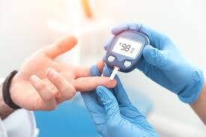



What Group of People Had The Biggest Risk Factor
For COVID-19?

Slide 23
Key Points
The total population is 1,143
Men were 60% of the population, and Women 40%
Total Deaths from COVID-19 is 319, 28% of population
Total Deaths with at least 1 comorbidity was 101, 32% of total deaths
68% of people with comorbidity died
More men died proportional to their % of the population by 8%
Less women died proportional to their % of the population by 13%
Hypertension was the comorbidity that appeared the most and with other comorbidities

Slide 24
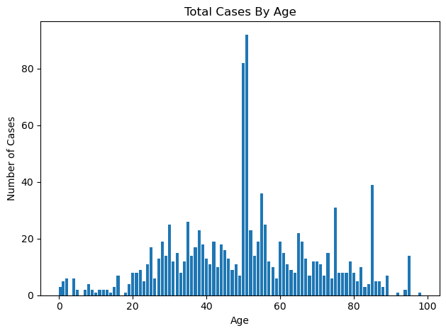
Age Group Distribution
The two largest age groups were 51 years old(92 cases), and 50 years old(82 cases).
The range of 8-49 and 52-98 were quite comparable with higher peaks in the 52-98 age groups resulting in a higher overall sample than the 8-49.
KR, 2

Slide 25
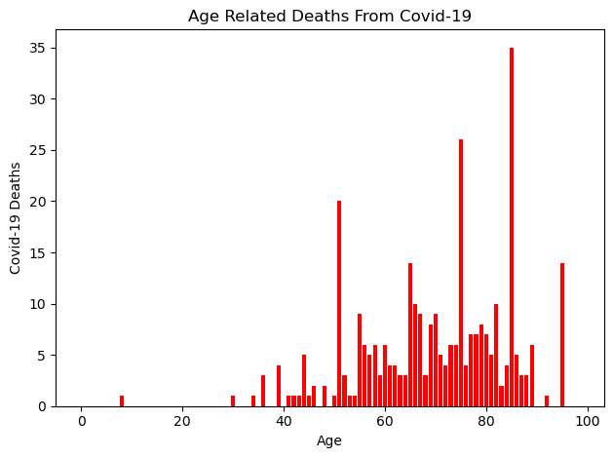
How age affects death rate
People over the age of 70 accounted for 55% of all deaths, people from the ages of 50-69 accounted for 37% of all deaths, and ages 8-49 accounted for just 8% of all deaths.
KR,3

Slide 26
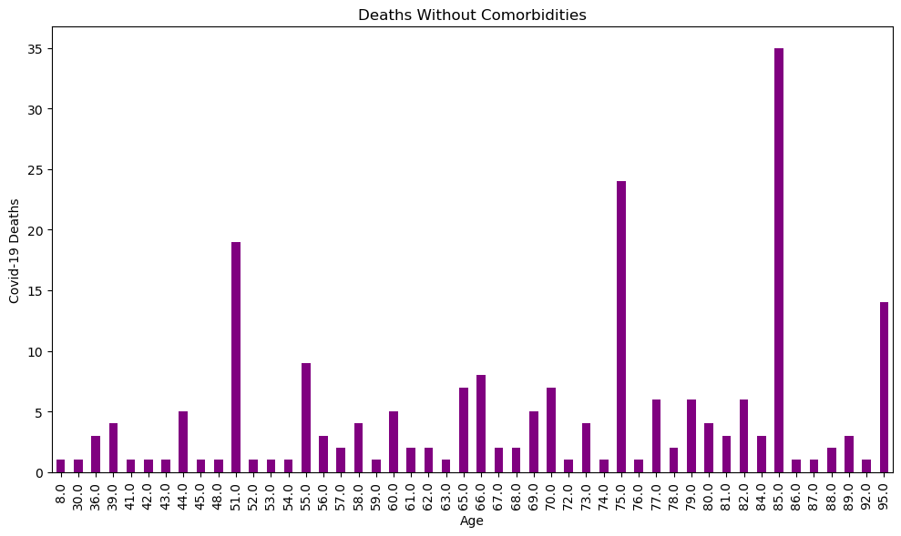
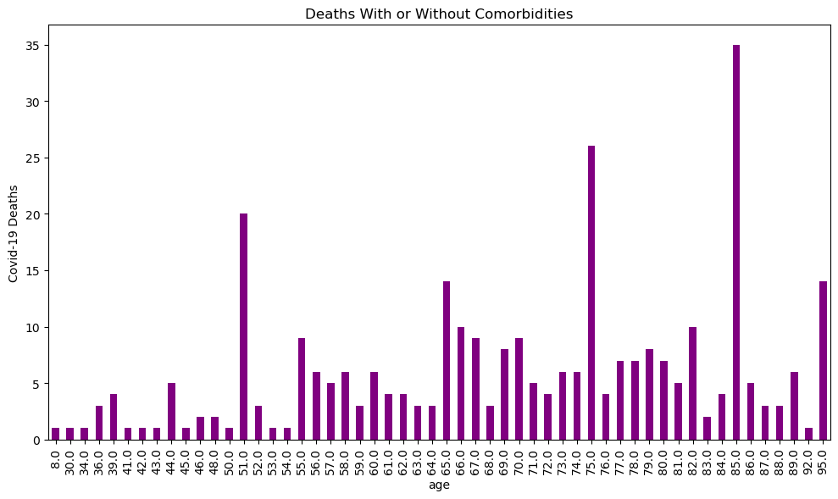
The Relationship Between Death & Comorbidities

Slide 27

Impact of COVID-19 on Mental Health Trends
How did mental health trends change during the pandemic?
Which demographic groups were most affected?
Is there a correlation between COVID-19 cases and mental health crises?

Slide 28
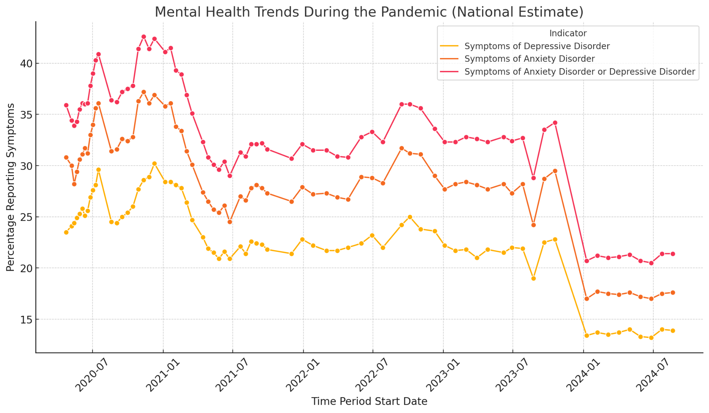
Overall Trends:
Both anxiety and depressive symptoms fluctuate throughout the pandemic, reflecting the psychological impact of different phases of COVID-19.
Noticeable spikes during certain periods indicate heightened mental health crises.
Key Observations:
Peaks correspond with significant pandemic events, such as lockdowns and COVID-19 case surges.
Symptoms did not return to pre-pandemic levels, showing a sustained psychological impact.
Relevance to Research Questions:
This graph directly answers how mental health trends changed during the pandemic.
It sets the context for understanding which demographic groups were most affected.

Slide 29
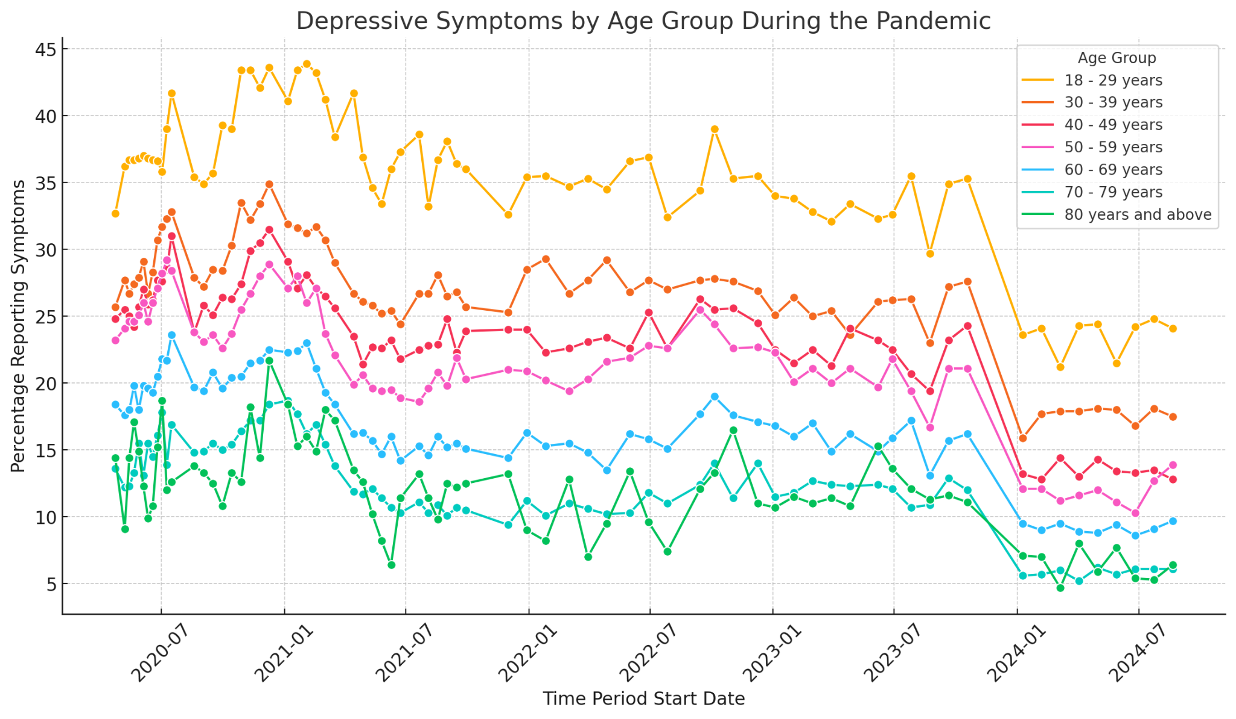
Young Adults Were Most Affected:
Young adults aged 18-29 consistently reported the highest levels of depressive symptoms.
This group showed the most significant spikes, reflecting the impact of social isolation and economic uncertainty.
Age-Wise Trends:
All age groups showed an increase in symptoms during the pandemic, but younger age groups were notably more affected.
Older adults showed lower but still significant levels of depressive symptoms.
Relevance to Research Questions:
This graph answers the question of which demographic groups were most affected.
It provides a clear visual of age-wise disparities in mental health impact.

Slide 30
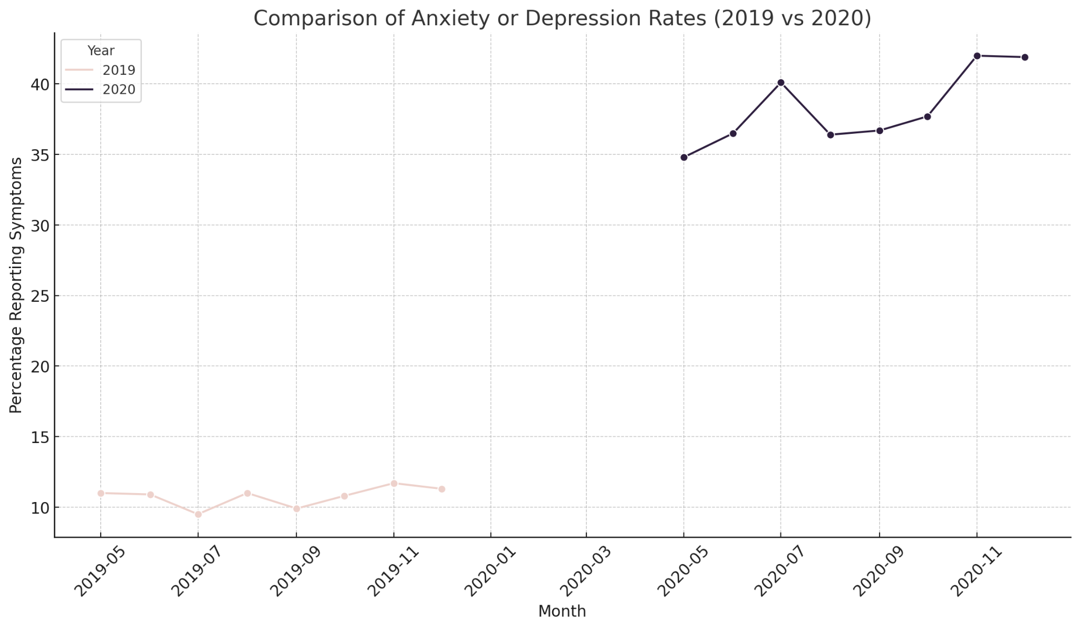
Pandemic Effects Begin (May 2020):
Anxiety and depression rates began to rise in May 2020, coinciding with the first lockdowns and heightened pandemic fears.
This initial increase reflects the immediate psychological impact of social isolation and economic uncertainties.
Highest Peak (July 2020):
The peak occurred in July 2020, reflecting prolonged social isolation and economic pressures.
This period also aligns with growing uncertainty about the pandemic's duration and severity.
Consistently Higher Symptoms in 2020:
Rates remained consistently elevated throughout the rest of 2020 compared to 2019.
This indicates the long-term psychological effects of the pandemic, including social distancing, economic instability, and health concerns.
Relevance to Research Questions:
This graph directly answers how mental health trends changed during the pandemic.
It provides evidence of the pandemic's sustained impact on mental health.

Slide 31
Conclusion:
The data highlights the effectiveness of COVID-19 vaccinations in reducing mortality rates, with a clear decrease in deaths corresponding to higher vaccination rates. The most vulnerable population remains men over 50 with comorbidities, emphasizing the need for targeted interventions for at-risk groups. Vaccination efforts, particularly in low-income countries, are crucial for further reducing mortality and controlling the spread of the virus.
By understanding these trends, we can better allocate resources and continue to focus on the most vulnerable populations to reduce the global impact of COVID-19.
There is also a complex relationship between the COVID-19 pandemic and mental health. While the direct impact of the virus on mental health was moderate, the societal changes it instigated had profound effects on mental well-being, particularly among younger populations. Understanding these trends is essential for preparing future public health responses, focusing not only on the physical health of populations but also on their mental resilience.

Slide 32
What Can Be Changed For The Better Next Time Around!
For the next project, it would be a better idea to have slightly less datasets to go through. It does a great job of thoroughly explaining a topic, and painting a full picture, but each dataset can answer so many questions.

